Slide 1
Lecture 12: Recurrent Neural Networks

Slide 2
Recall: PyTorch vs TensorFlow
PyTorch
My personal favorite
Clean, imperative API
Easy dynamic graphs for debugging
JIT allows static graphs for production
Cannot use TPUs
Not easy to deploy on mobile
TensorFlow 1.0
Static graphs by default
Can be confusing to debug
API a bit messy
TensorFlow 2.0
Dynamic by default
Standardized on Keras API
Just came out, no consensus yet

Slide 3
Recall: PyTorch vs TensorFlow
PyTorch 1.3 (Released 10/10/2019)
My personal favorite
Clean, imperative API
Easy dynamic graphs for debugging
JIT allows static graphs for production
TPU support with pytorch/xla!
(Experimental) mobile support on Android and iOS!
TensorFlow 1.0
Static graphs by default
Can be confusing to debug
API a bit messy
TensorFlow 2.0
Dynamic by default
Standardized on Keras API
Just came out, no consensus yet

Slide 4
Last Time: Training Neural Networks
One time setup
Activation functions, data preprocessing, weight initialization, regularization
Training dynamics
Learning rate schedules; hyperparameter optimization
After training
Model ensembles, transfer learning, large-batch training

Slide 5
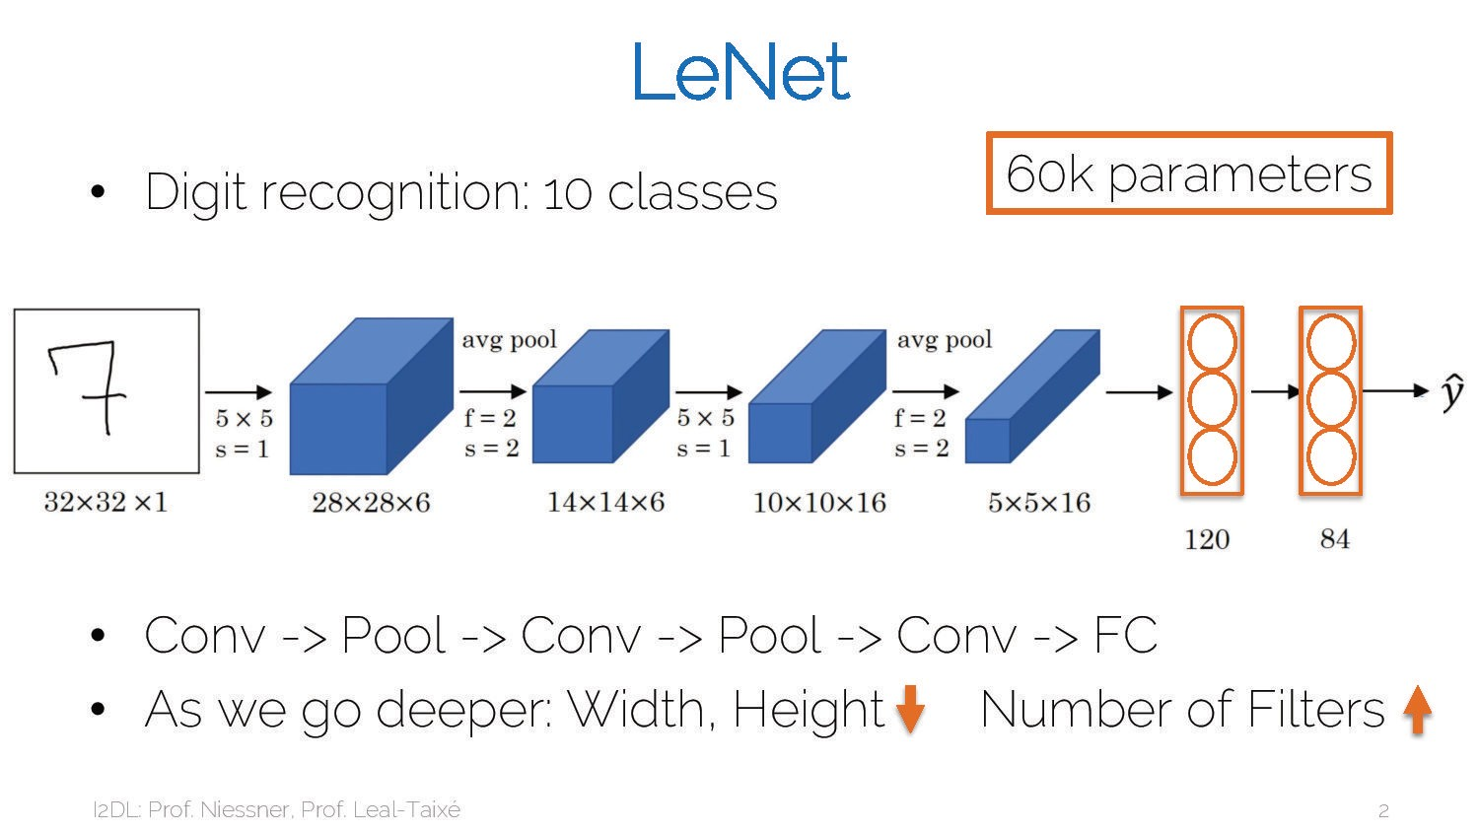

Slide 6
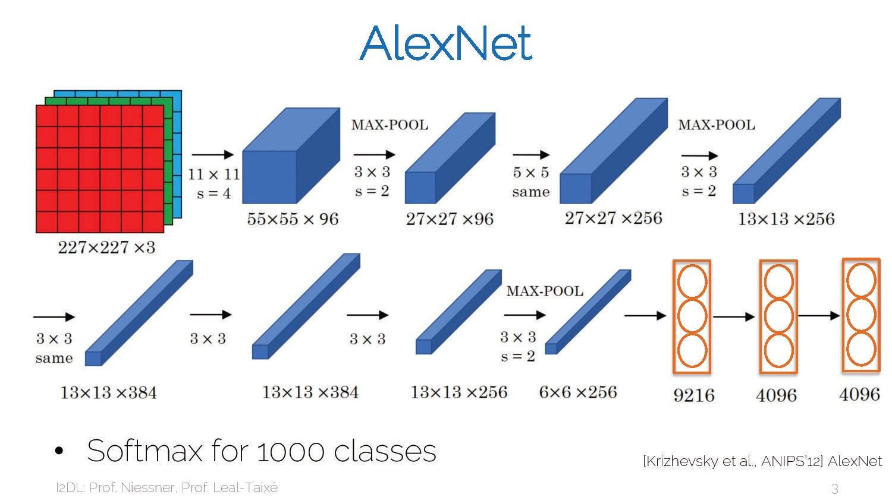

Slide 7
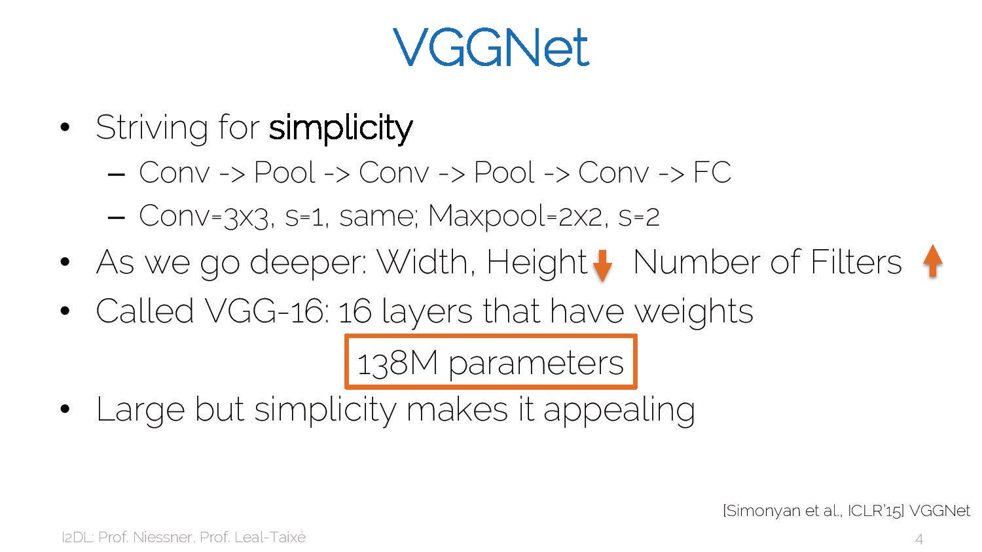

Slide 8
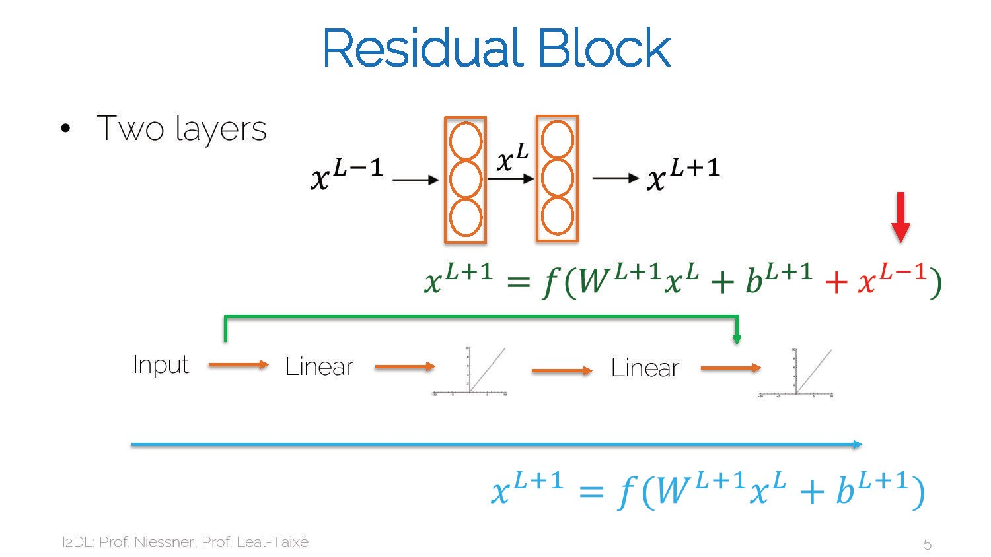

Slide 9
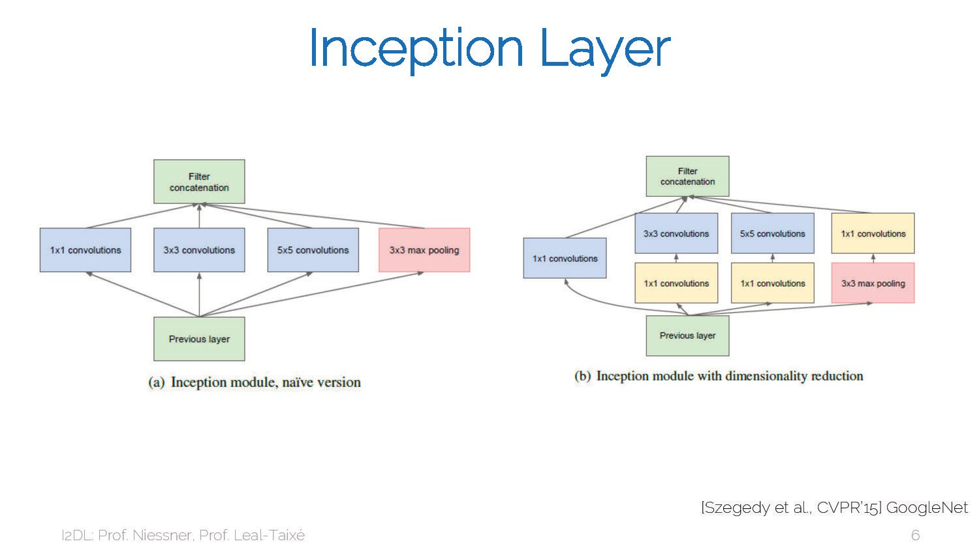

Slide 10


Slide 11
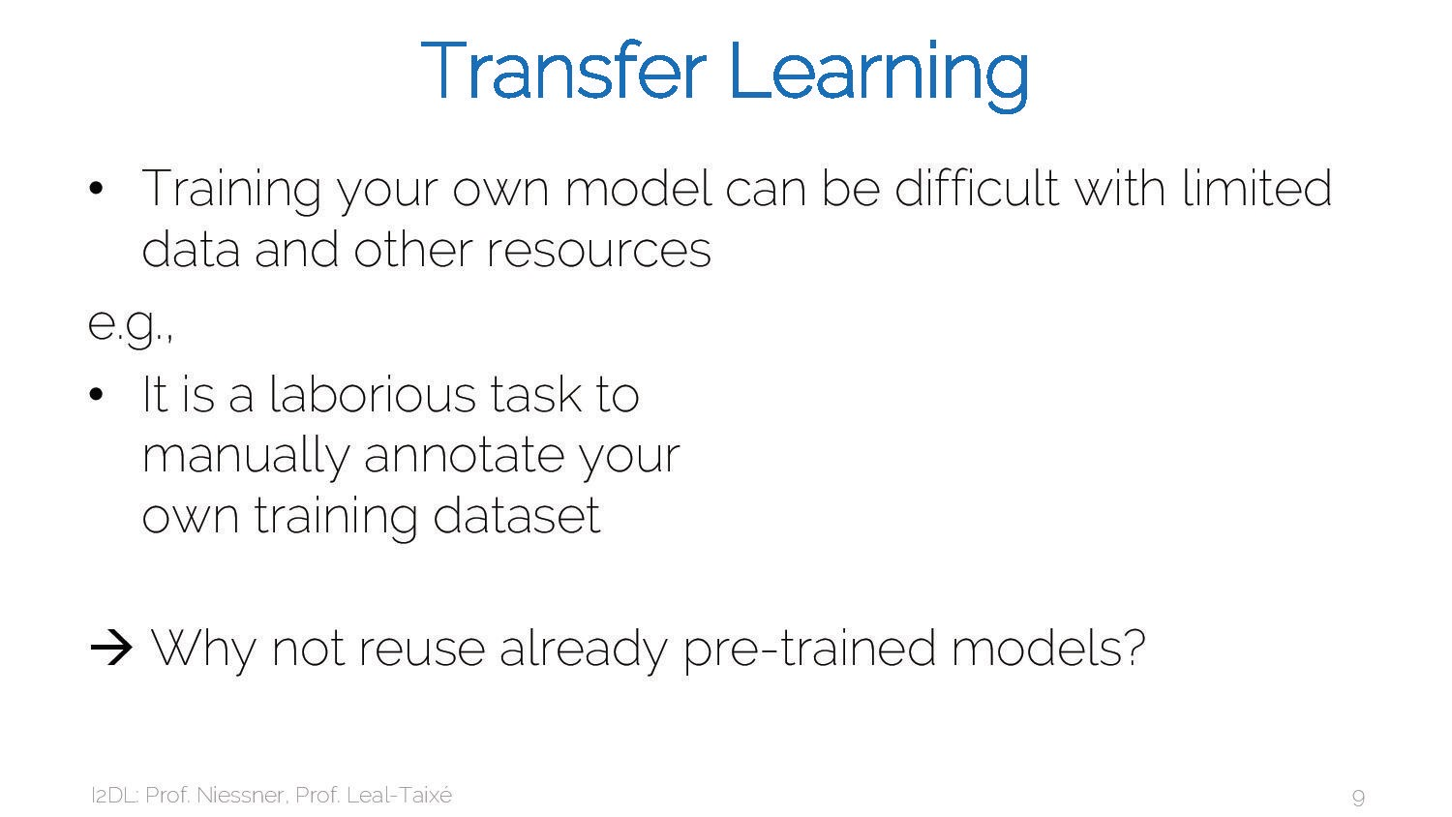

Slide 12
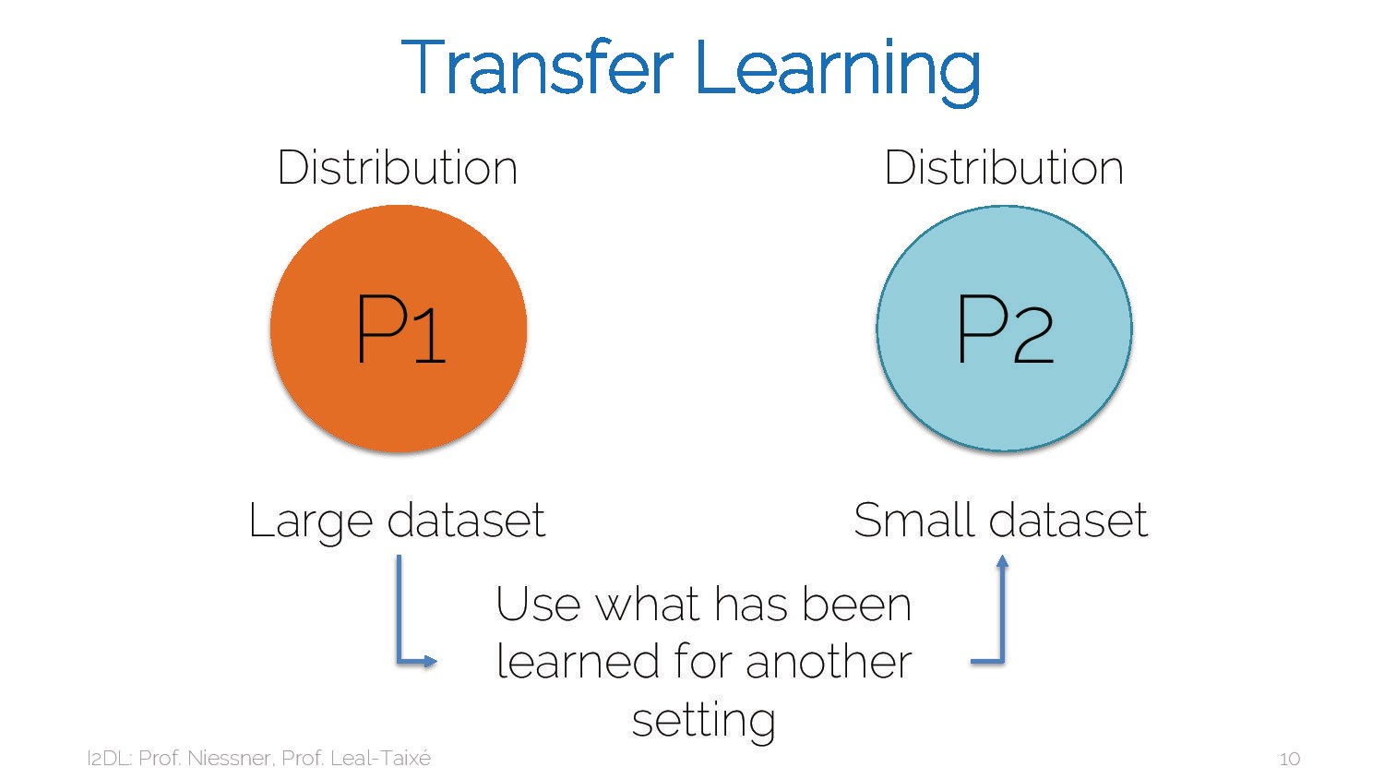

Slide 13
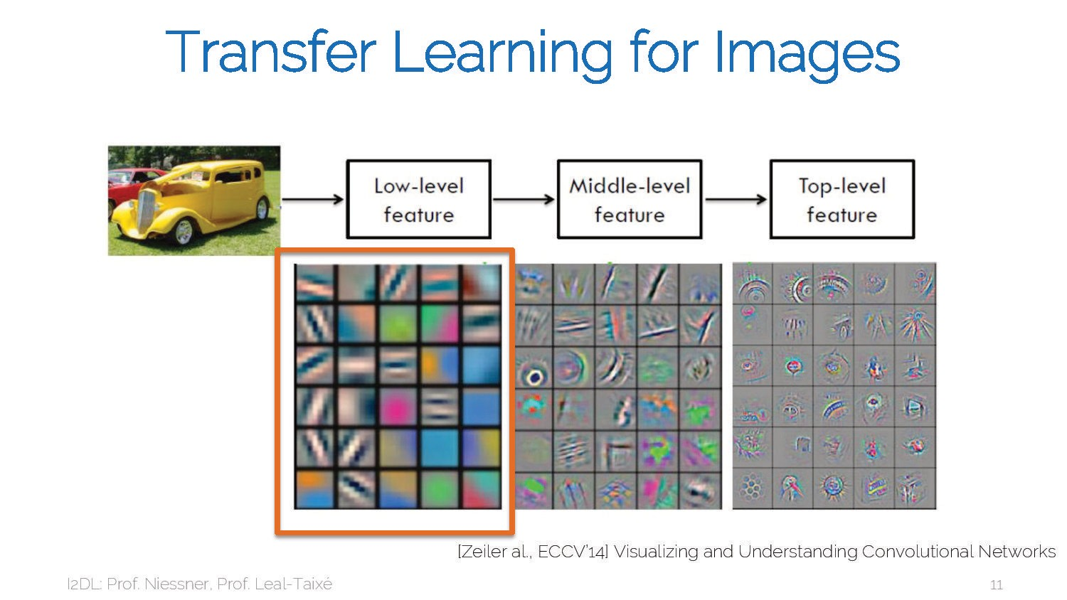

Slide 14
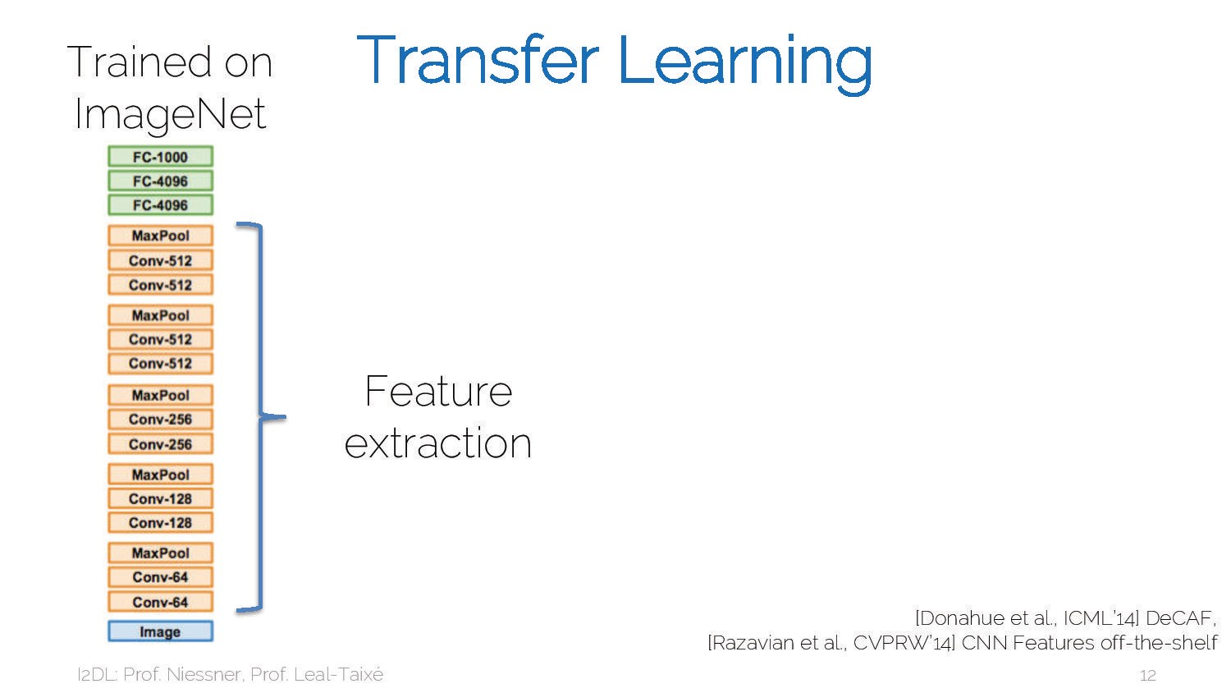

Slide 15
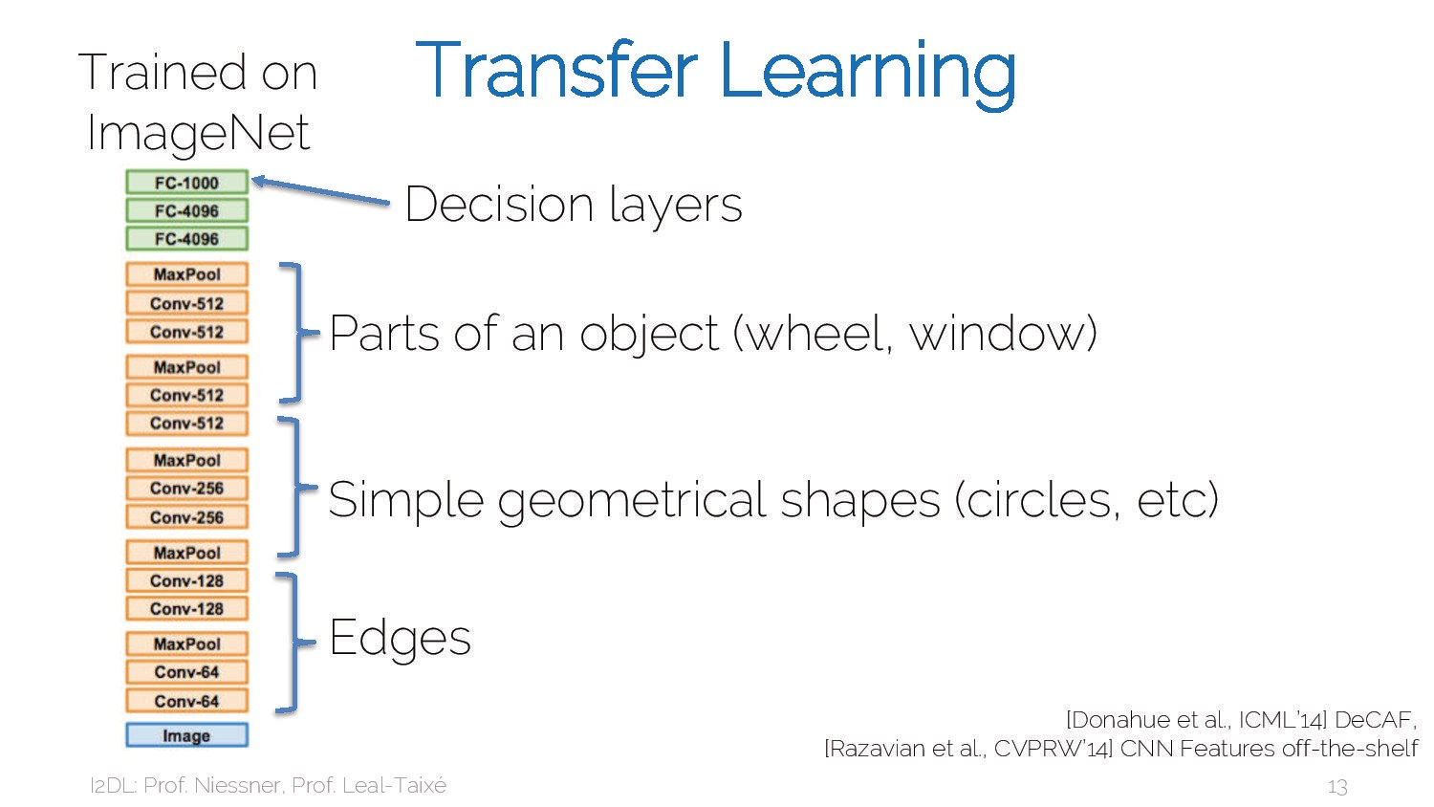

Slide 16
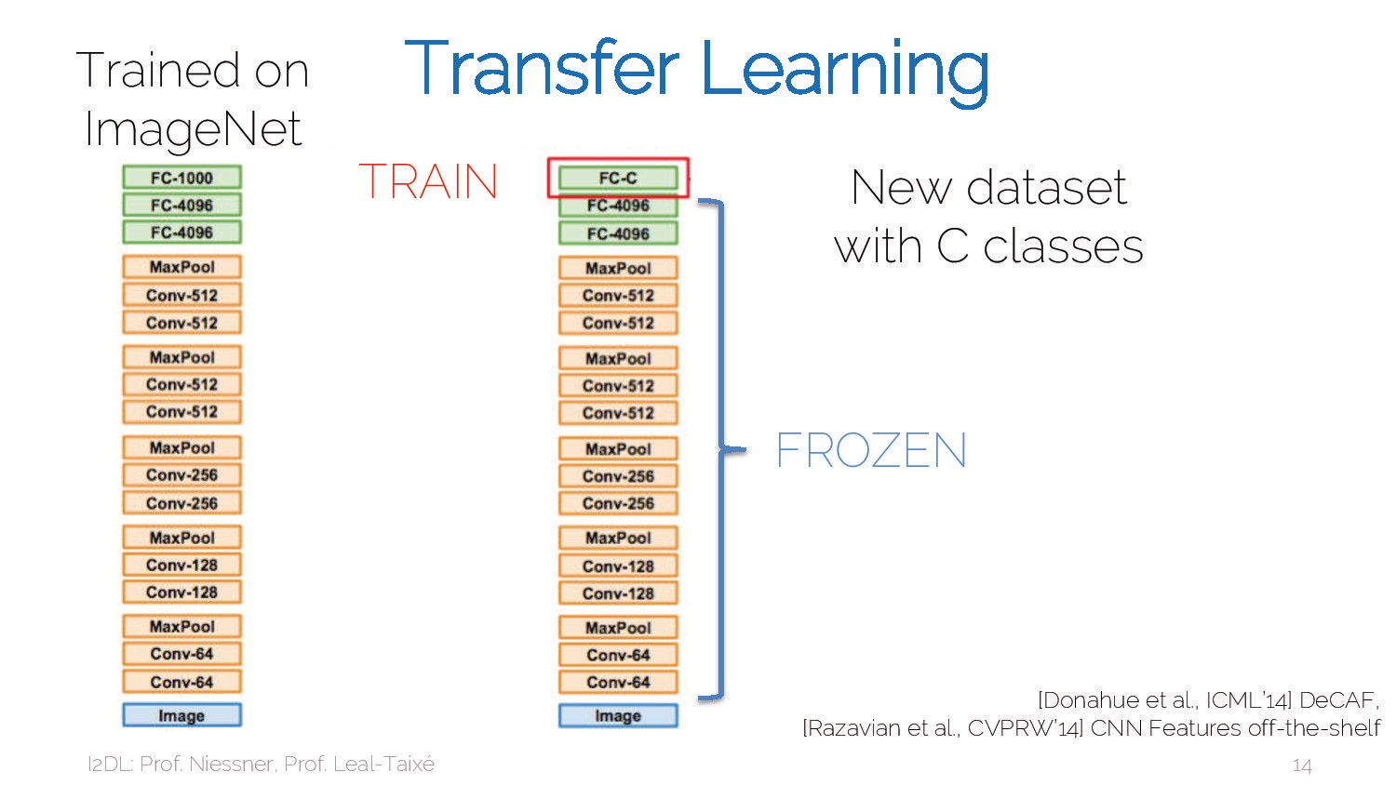

Slide 17
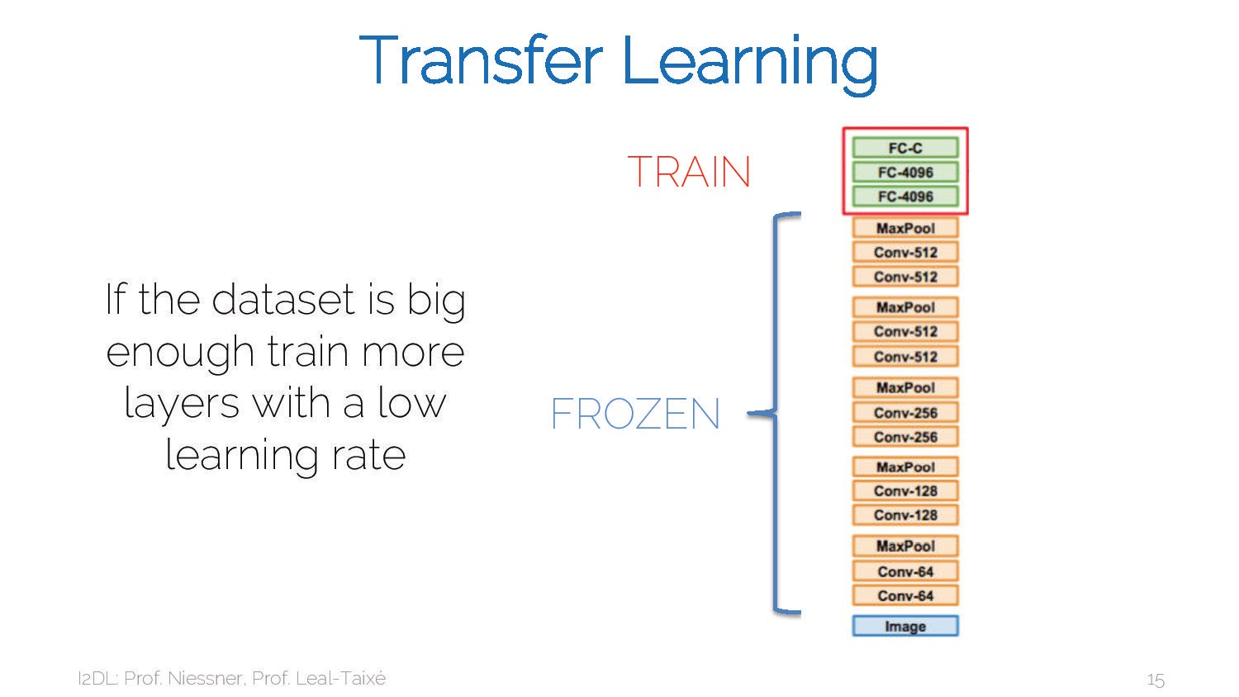

Slide 18
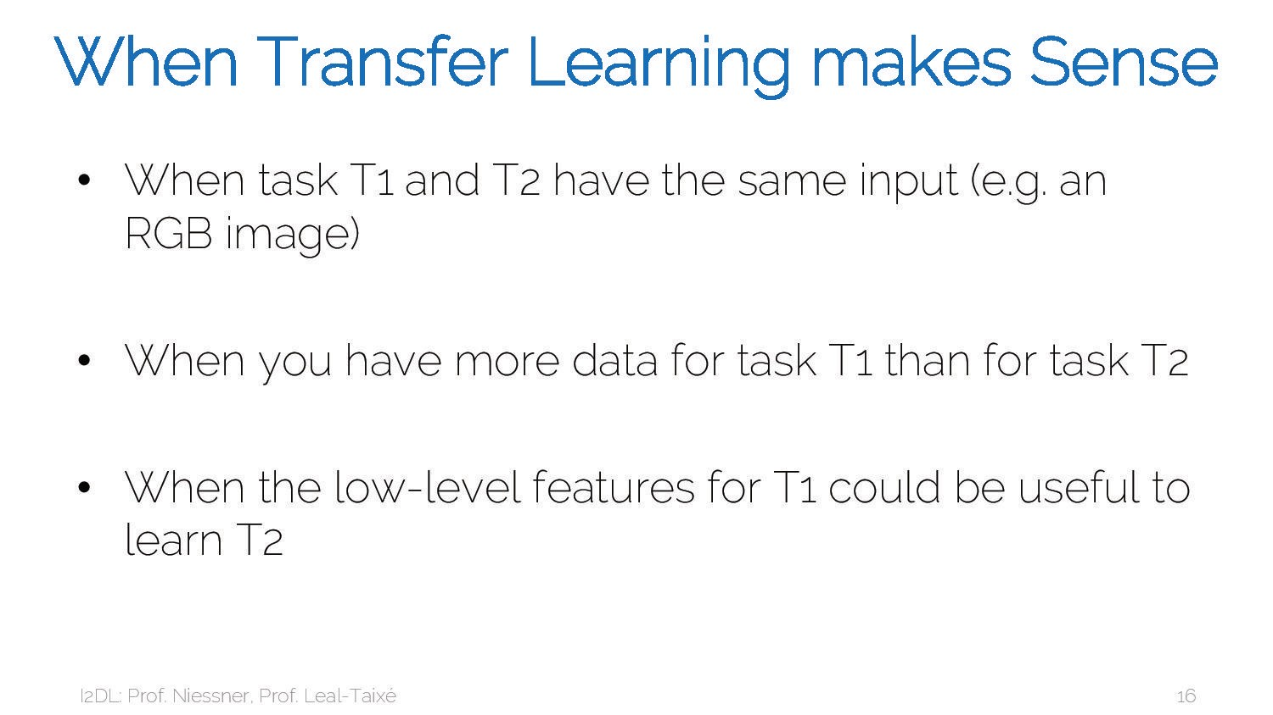

Slide 19
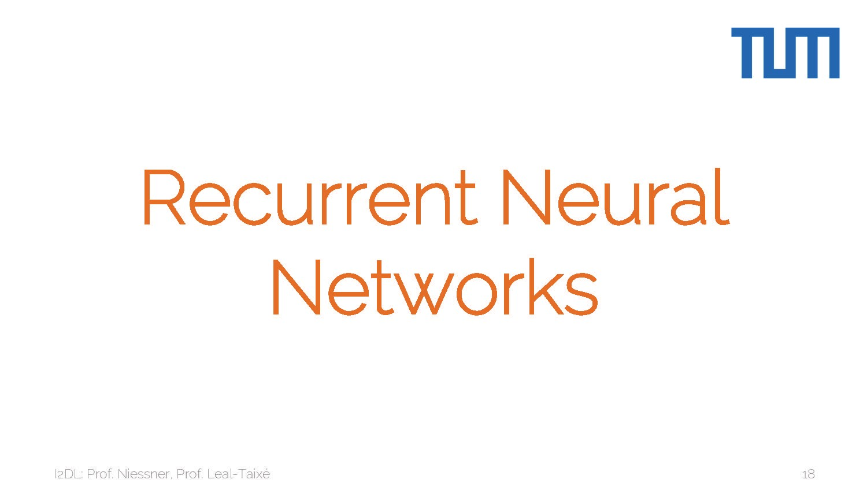

Slide 20
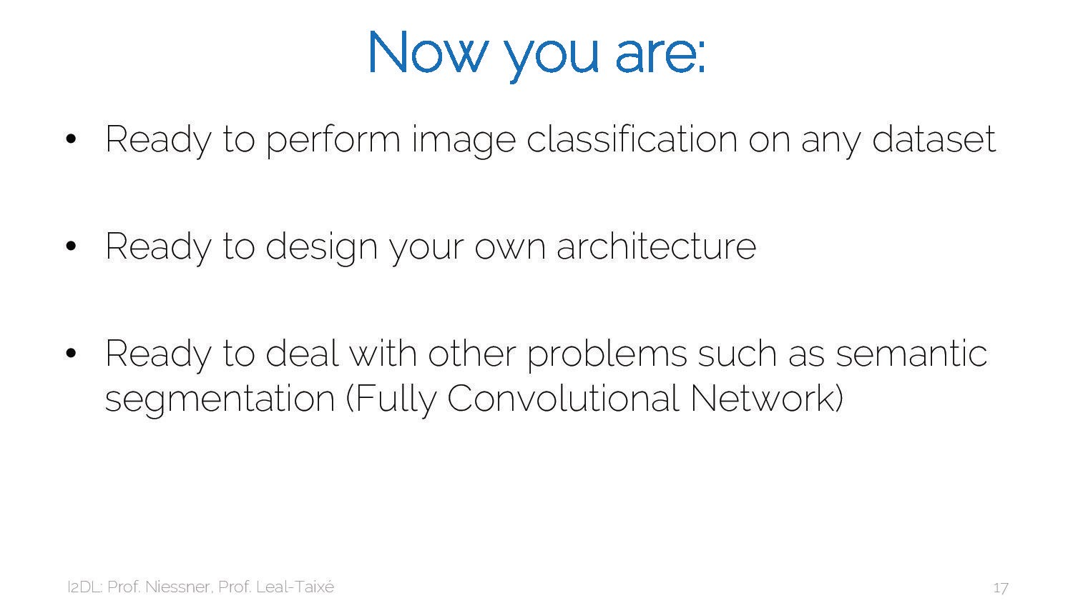

Slide 21
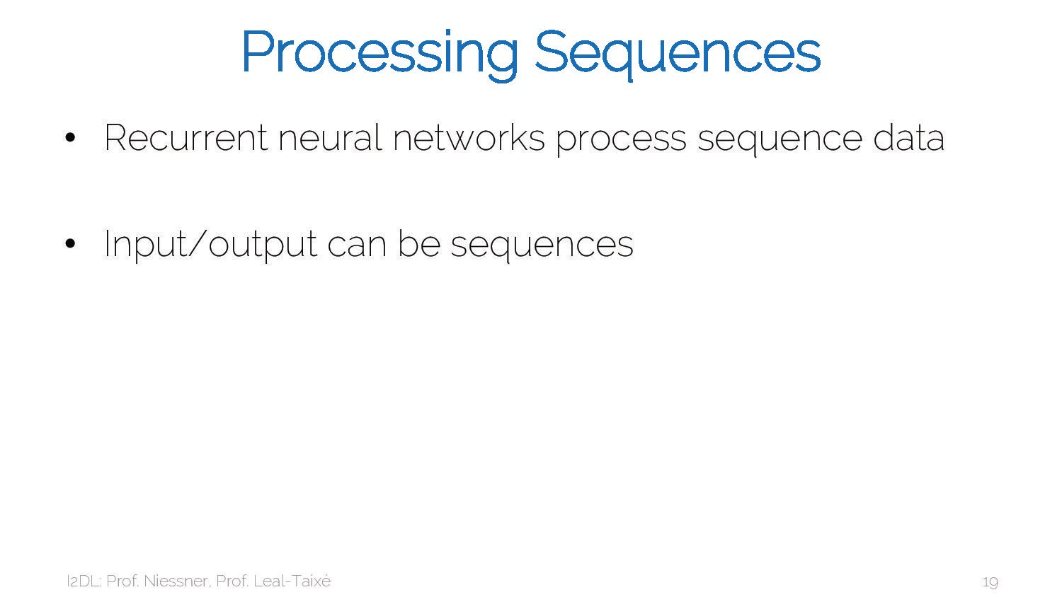

Slide 22
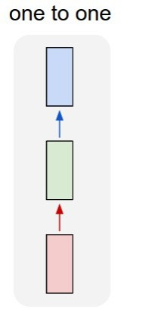
So far: “Feedforward” Neural Networks
e.g. Image classification Image -> Label

Slide 23
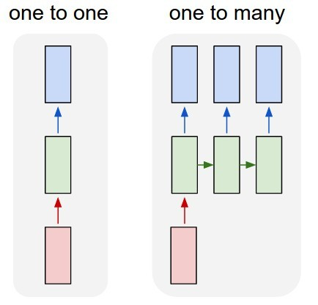
Recurrent Neural Networks: Process Sequences
e.g. Image Captioning: Image -> sequence of words

Slide 24
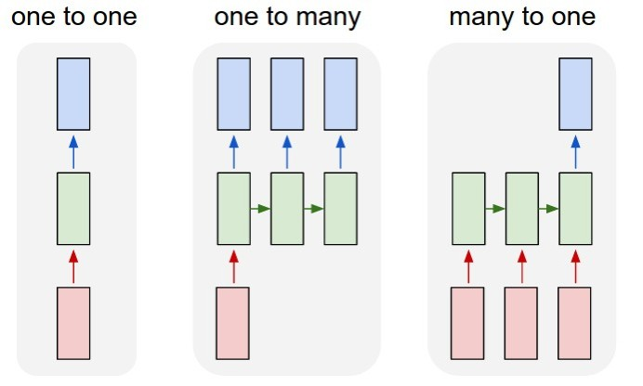
Recurrent Neural Networks: Process Sequences
e.g. Video classification: Sequence of images -> label

Slide 25
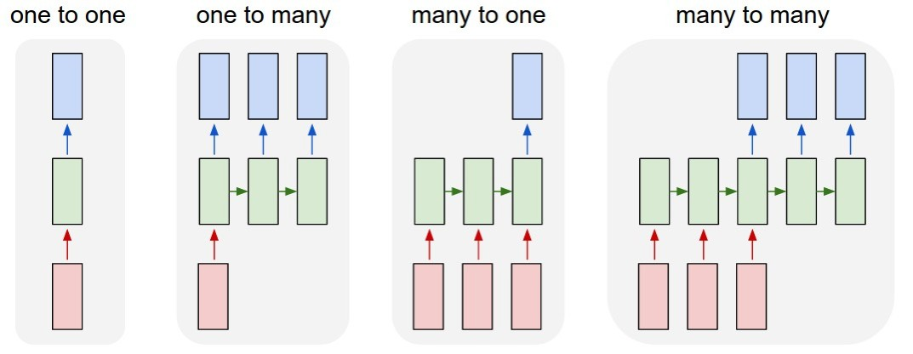
Recurrent Neural Networks: Process Sequences
e.g. Machine Translation:
Sequence of words -> Sequence of words
Lecture 12 - 10

Slide 26
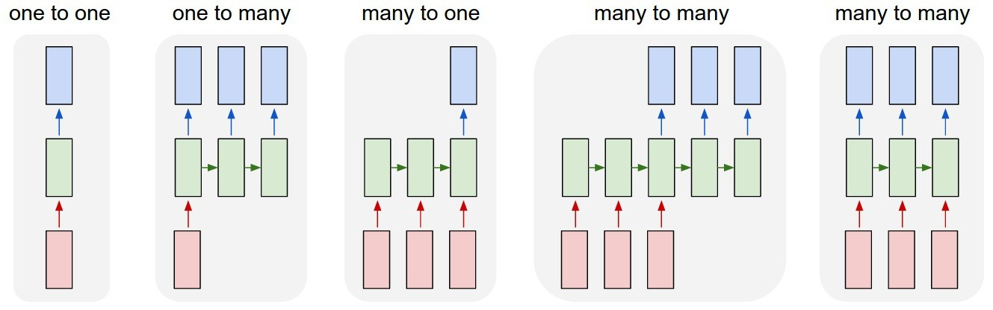
Recurrent Neural Networks: Process Sequences
e.g. Per-frame video classification: Sequence of images -> Sequence of labels

Slide 27
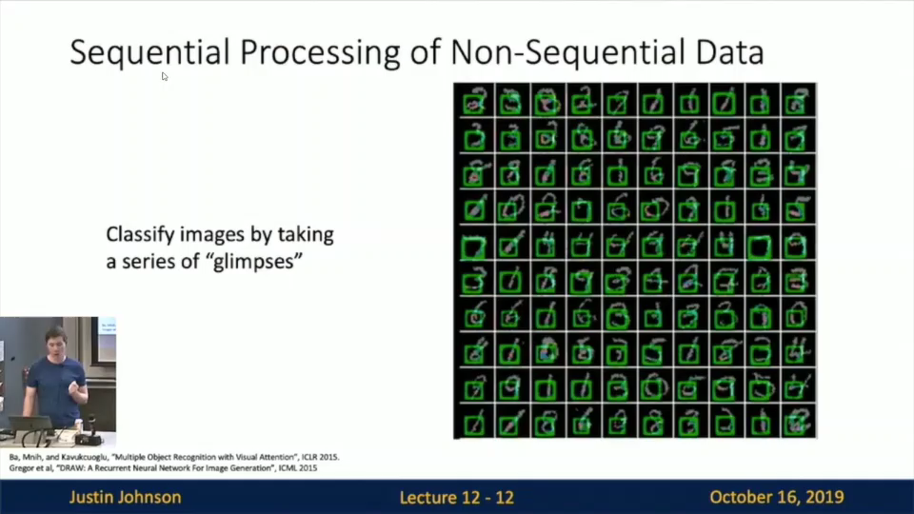

Slide 28
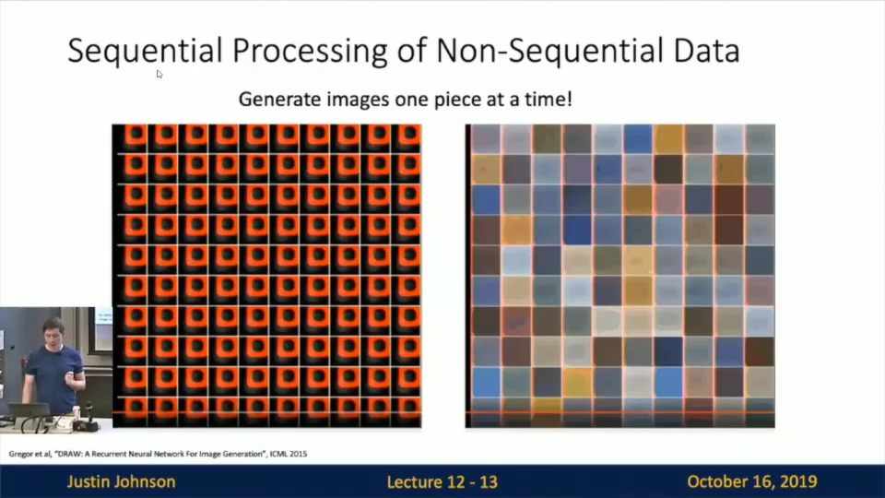

Slide 29
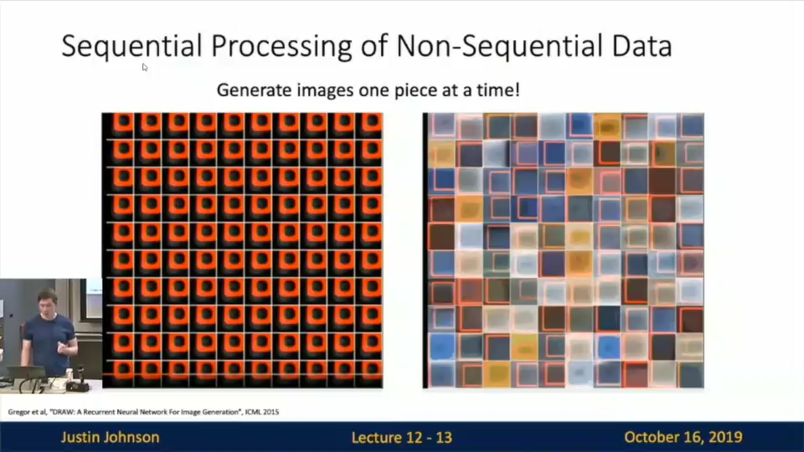

Slide 30
Recurrent Neural Networks
y
Key idea: RNNs have an “internal state” that is updated as a sequence is processed
RNN
x

Slide 31
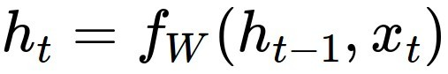
Recurrent Neural Networks
y
We can process a sequence of vectors x by applying a
recurrence formula at every time step:
RNN
new state
old state
input vector at some time step
x
some function with parameters W

Slide 32
Recurrent Neural Networks
Notice: the same function and the same set of parameters are used at every time step.
y
We can process a sequence of vectors x by applying a
recurrence formula at every time step:
RNN
new state
old state
input vector at some time step
x
some function with parameters W

Slide 33
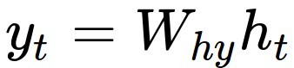
(Vanilla) Recurrent Neural Networks
The state consists of a single “hidden” vector h:
y
RNN
(also bias term)
x
Sometimes called a “Vanilla RNN” or an “Elman RNN” after Prof. Jeffrey Elman

Slide 34
RNN Computational Graph
Initial hidden state Either set to all 0, Or learn it
h₀
x₁

Slide 35
RNN Computational Graph
h₀
h₁
f_{W}
x₁
Lecture 12 - 20

Slide 36
RNN Computational Graph
h₀
h₁
h₂
f_{W}
f_{W}
x₁
x₂

Slide 37
RNN Computational Graph
h₀
h₁
h₂
h₃
h_{T}
f_{W}
f_{W}
f_{W}
…
x₁
x₂
x₃

Slide 38
RNN Computational Graph
Re-use the same weight matrix at every time-step
h₃
h_{T}
f_{W}
f_{W}
f_{W}
…
h₀
h₁
h₂
x₁
x₂
x₃
W

Slide 39
RNN Computational Graph (Many to Many)
y₁
y₂
y₃
y_{T}
h₃
h_{T}
f_{W}
f_{W}
f_{W}
…
h₀
h₁
h₂
x₁
x₂
x₃
W

Slide 40
RNN Computational Graph (Many to Many)
y₁
y₂
y₃
y_{T}
L₁
L₂
L₃
L_{T}
h₃
h_{T}
f_{W}
f_{W}
f_{W}
…
h₀
h₁
h₂
x₁
x₂
x₃
W

Slide 41
RNN Computational Graph (Many to Many)
L
y₁
L₁
y₂
L₂
y₃
L₃
y_{T}
L_{T}
h₃
h_{T}
f_{W}
f_{W}
f_{W}
…
h₀
h₁
h₂
x₁
x₂
x₃
W

Slide 42
RNN Computational Graph (Many to One)
y
h₃
h_{T}
f_{W}
f_{W}
f_{W}
…
h₀
h₁
h₂
x₁
x₂
x₃
W

Slide 43
RNN Computational Graph (One to Many)
y₁
y₂
y₃
y_{T}
h₃
h_{T}
f_{W}
f_{W}
f_{W}
…
h₀
h₁
h₂
x
W

Slide 44
Sequence to Sequence (seq2seq) (Many to one) + (One to many)
Many to one: Encode input sequence in a single vector
f_{W}
f_{W}
f_{W}
…
h₀
h₁
h₂
h₃
h_{T}
x₁
x₂
x₃
W₁
Sutskever et al, “Sequence to Sequence Learning with Neural Networks”, NIPS 2014

Slide 45
Sequence to Sequence (seq2seq) (Many to one) + (One to many)
One to many: Produce output sequence from single input vector
Many to one: Encode input sequence in a single vector
y₁
y₂
f_{W}
f_{W}
f_{W}
…
f_{W}
f_{W}
f_{W}
…
h₀
h₁
h₂
h₃
h_{T}
h
1
h
2
x₁
x₂
x₃
W₁
W₂
Sutskever et al, “Sequence to Sequence Learning with Neural Networks”, NIPS 2014

Slide 46
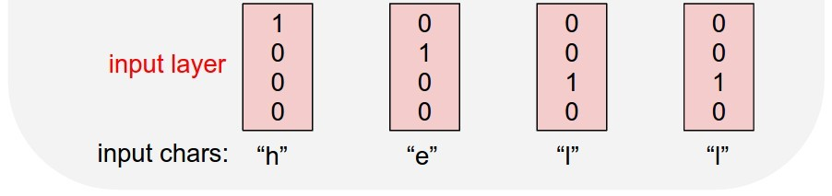
Example: Language Modeling
Given characters 1, 2, …, t, model predicts character t
Training sequence: ”hello” Vocabulary: [h, e, l, o]

Slide 47
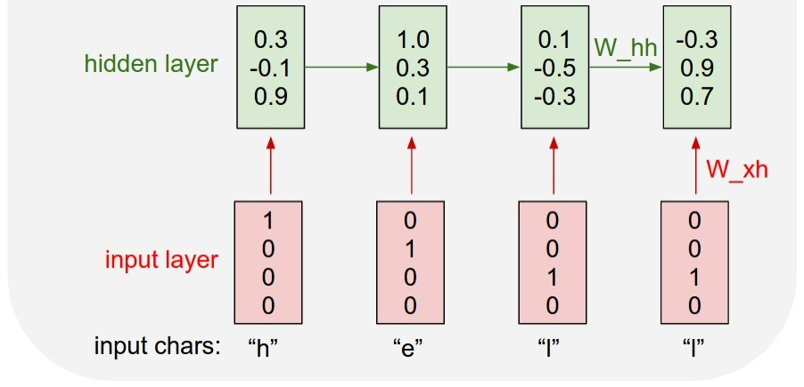
Example: Language Modeling
Given characters 1, 2, …, t, model predicts character t
Training sequence: ”hello” Vocabulary: [h, e, l, o]

Slide 48
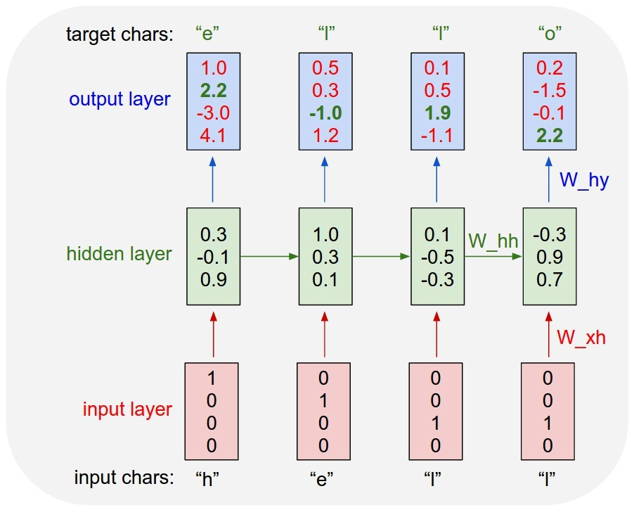
Example: Language Modeling
Given characters 1, 2, …, t, model predicts character t
Training sequence: ”hello” Vocabulary: [h, e, l, o]

Slide 49
Example: Language Modeling
Given “h”, predict “e”
Given characters 1, 2, …, t, model predicts character t
Training sequence: ”hello” Vocabulary: [h, e, l, o]

Slide 50
Example: Language Modeling
Given “he”, predict “l”
Given characters 1, 2, …, t, model predicts character t
Training sequence: ”hello” Vocabulary: [h, e, l, o]

Slide 51
Example: Language Modeling
Given “hel”, predict “l”
Given characters 1, 2, …, t, model predicts character t
Training sequence: ”hello” Vocabulary: [h, e, l, o]

Slide 52
Example: Language Modeling
Given “hell”, predict “o”
Given characters 1, 2, …, t, model predicts character t
Training sequence: ”hello” Vocabulary: [h, e, l, o]

Slide 53
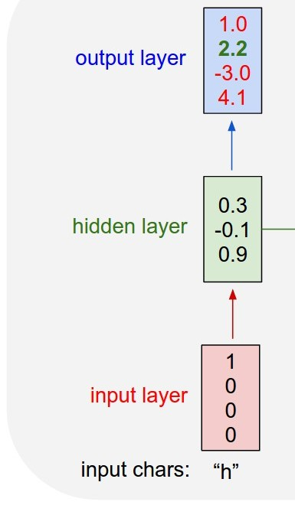
Example: Language Modeling
“e
Sample
”
.03
.13
.00
.84
Softmax
At test-time, generate new text: sample characters one at a time, feed back to model
Training sequence: ”hello” Vocabulary: [h, e, l, o]

Slide 54
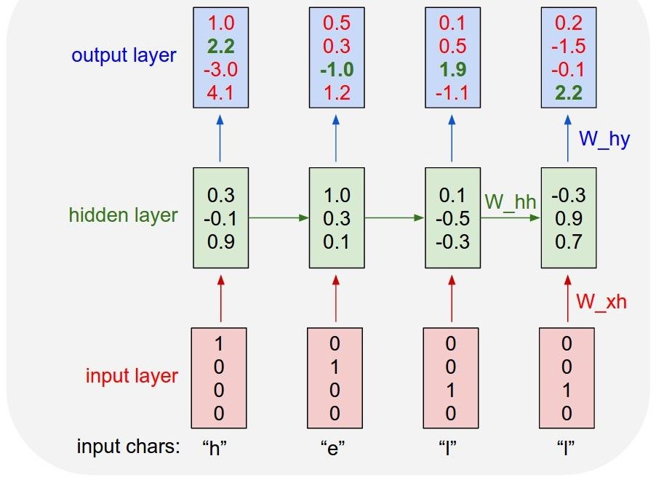
Example: Language Modeling
“e
Sample
”
.03
.13
.00
.84
Softmax
At test-time, generate new text: sample characters one at a time, feed back to model
Training sequence: ”hello” Vocabulary: [h, e, l, o]

Slide 55
Example: Language Modeling
“e
“l
Sample
”
”
.03
.13
.00
.84
.25
.20
.05
.50
Softmax
At test-time, generate new text: sample characters one at a time, feed back to model
Training sequence: ”hello” Vocabulary: [h, e, l, o]
Lecture 12 - 40

Slide 56
Example: Language Modeling
“e
“l
“l
“o
Sample
”
”
”
”
.03
.13
.00
.84
.25
.20
.05
.50
.11
.17
.68
.03
.11
.02
.08
.79
Softmax
At test-time, generate new text: sample characters one at a time, feed back to model
Training sequence: ”hello” Vocabulary: [h, e, l, o]

Slide 57
Example: Language Modeling
“e
“l
“l
“o
Sample
”
”
”
”
So far: encode inputs as one-hot-vector
.03
.13
.00
.84
.25
.20
.05
.50
.11
.17
.68
.03
.11
.02
.08
.79
Softmax
[w₁₁ w₁₂ w₁₃ w₁₄] [1] [w₁₁]
[w₂₁ w₂₂ w₂₃ w₁₄] [0] = [w₂₁]
[w₃₁ w₃₂ w₃₃ w₁₄] [0] [w₃₁]
[0]
Matrix multiply with a one-hot vector just extracts a column from the weight matrix. Often extract this into a separate embedding layer

Slide 58
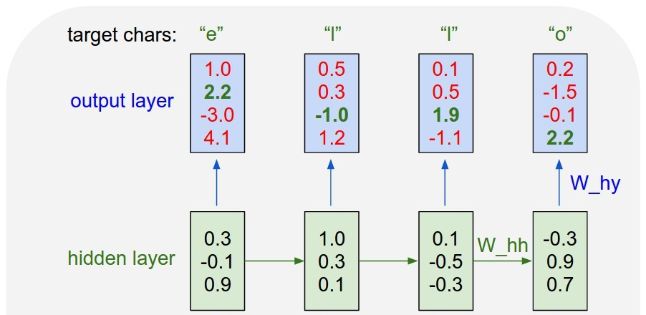
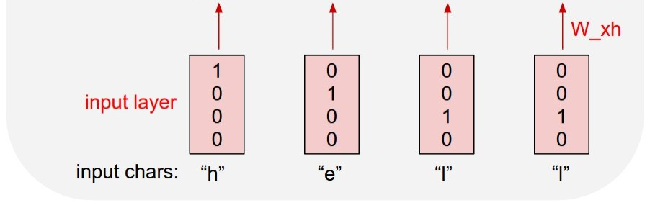
Example: Language Modeling
So far: encode inputs as one-hot-vector
[w₁₁ w₁₂ w₁₃ w₁₄] [1] [w₁₁] [w₂₁ w₂₂ w₂₃ w₁₄] [0] = [w₂₁]
.03 | .25 | .11 | .11
.13 | .20 | .17 | .02
.00 | .05 | .68 | .08
.84 | .50 | .03 | .79
[w₃₁ w₃₂ w₃₃ w₁₄] [0] [w₃₁]
[0]
Embedding
layer
Matrix multiply with a one-hot vector just extracts a column from the weight matrix. Often extract this into a separate embedding layer

Slide 59
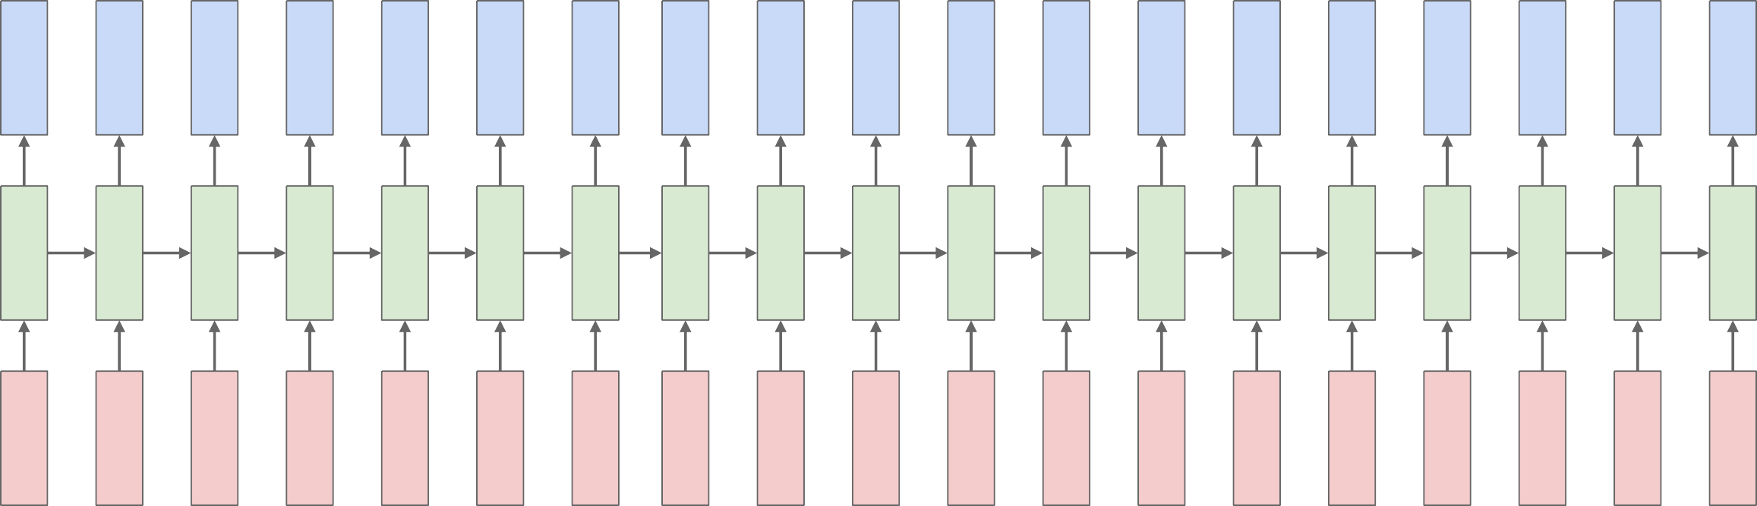
Backpropagation Through Time
Forward through entire sequence to compute loss, then backward through entire sequence to compute gradient
Loss

Slide 60
Backpropagation Through Time
Forward through entire sequence to compute loss, then backward through entire sequence to compute gradient
Problem: Takes a lot of memory for long sequences!
Loss

Slide 61
Truncated Backpropagation Through Time
Loss
Run forward and backward through chunks of the sequence instead of whole sequence

Slide 62
Truncated Backpropagation Through Time
Loss
Carry hidden states forward in time forever, but only backpropagate for some smaller number of steps

Slide 63
Truncated Backpropagation Through Time
Loss

Slide 64
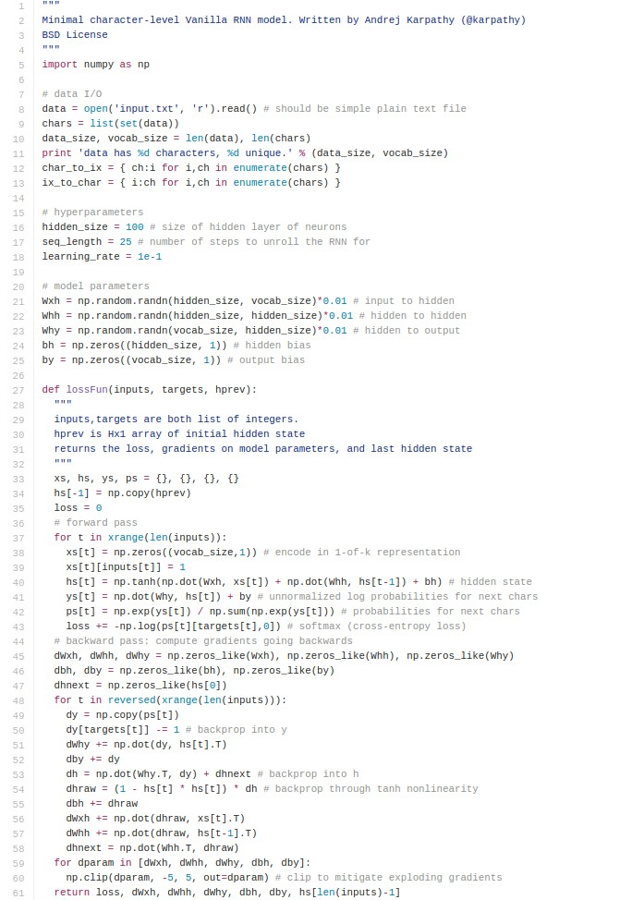
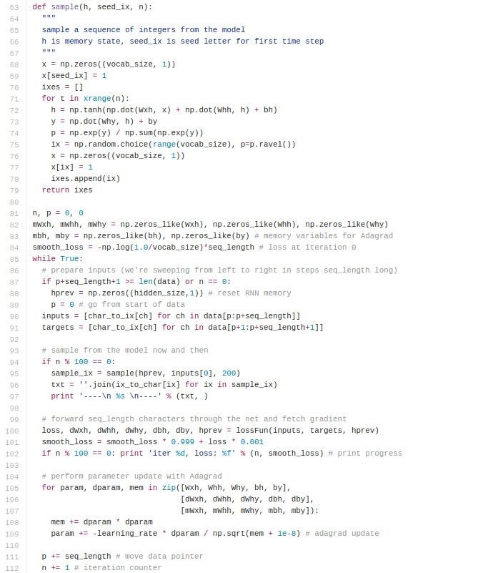
min-char-rnn.py: 112 lines of Python
(https://gist.github.com/karp athy/d4dee566867f8291f086)

Slide 65
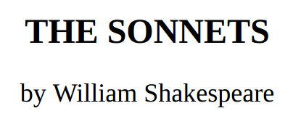
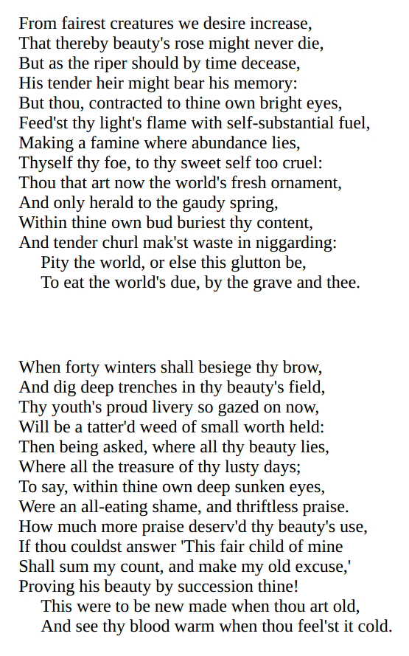
y
RNN
x
Lecture 12 - 50

Slide 66
at first:

Slide 67
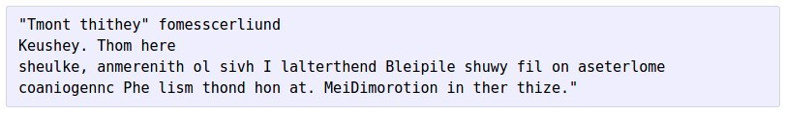
at first:
train more

Slide 68
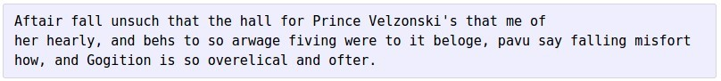
at first:
train more
train more

Slide 69
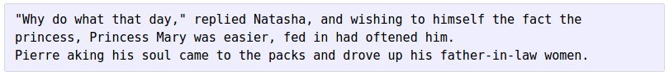
at first:
train more
train more
train more

Slide 70
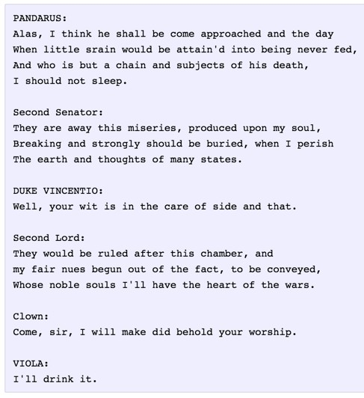
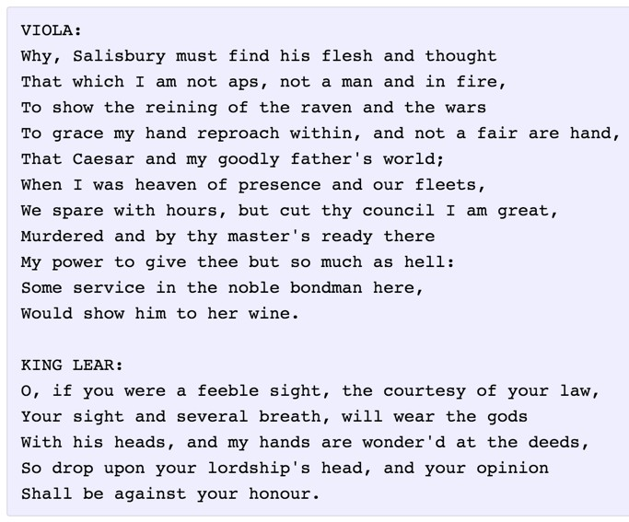

Slide 71
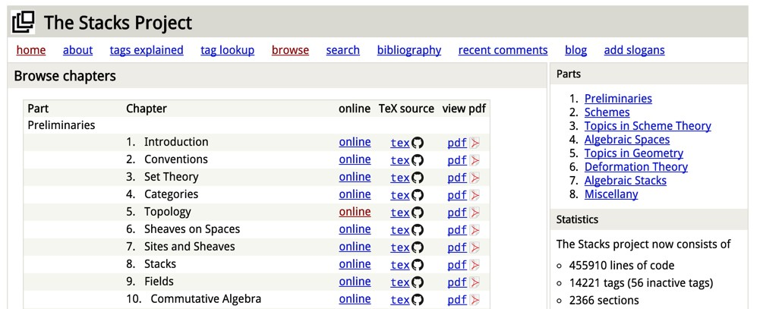
The Stacks Project: Open-Source Algebraic Geometry Textbook
Latex source
http://stacks.math.columbia.edu/
The stacks project is licensed under the GNU Free Documentation License

Slide 72
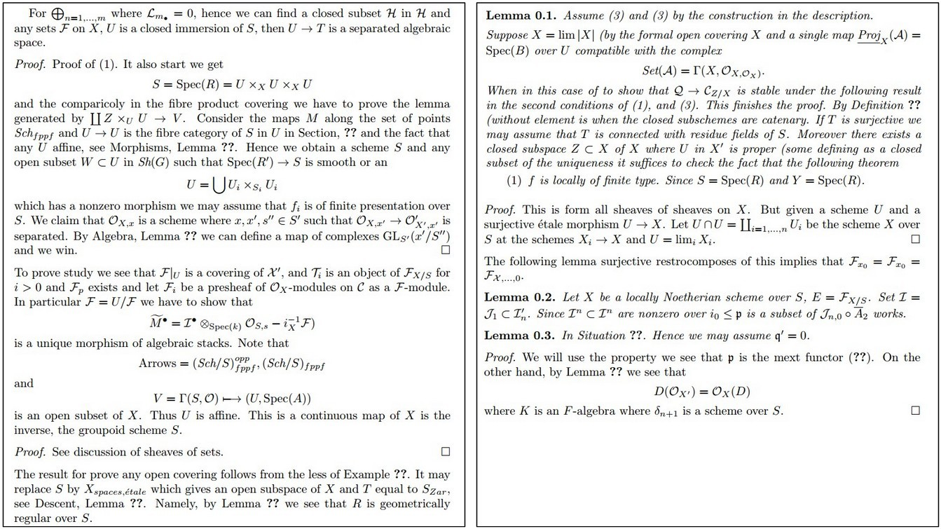

Slide 73
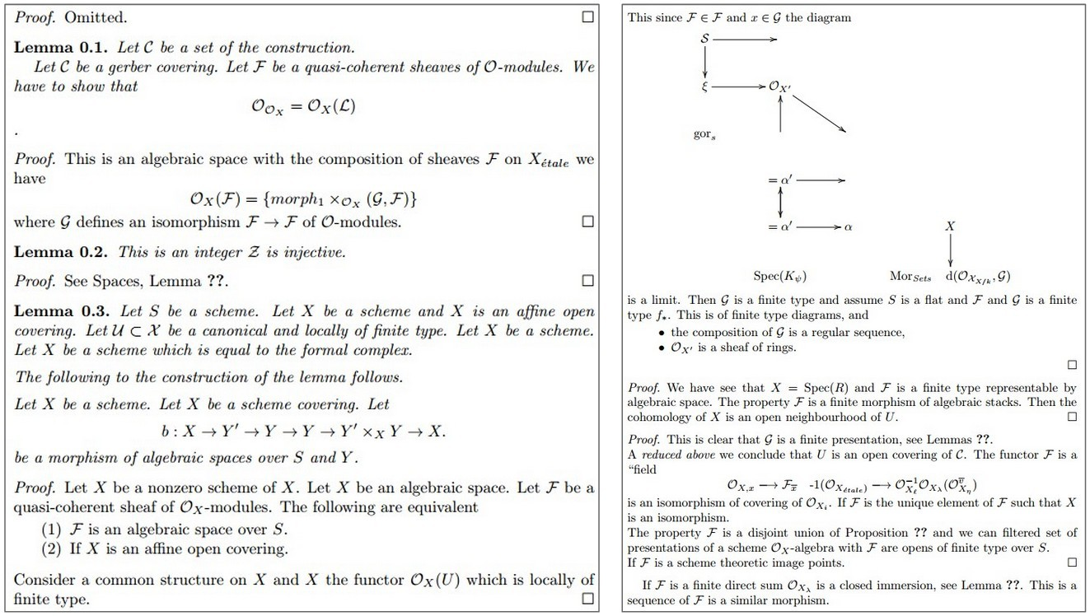

Slide 74
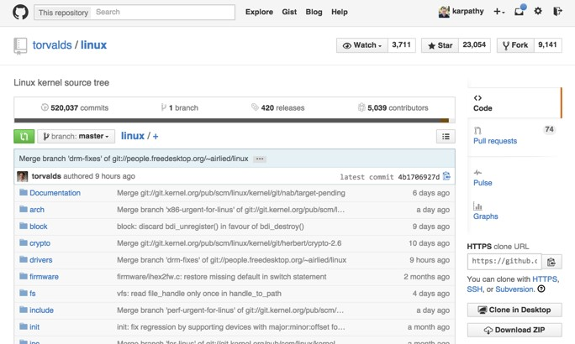

Slide 75
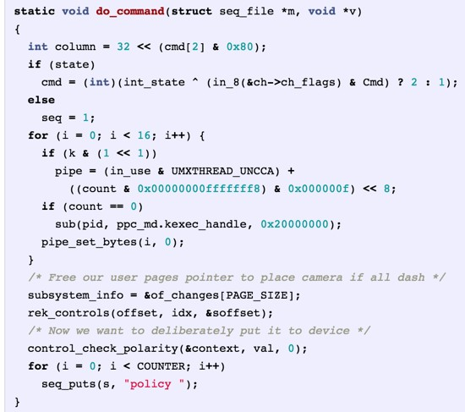
Generated C code
Lecture 12 - 60

Slide 76
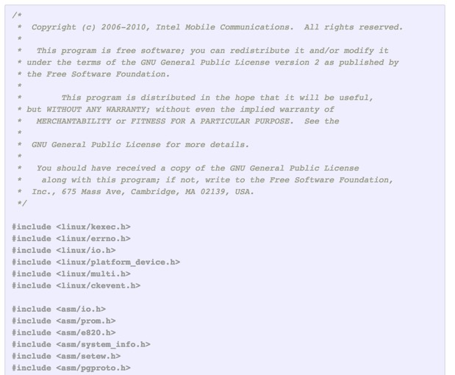

Slide 77
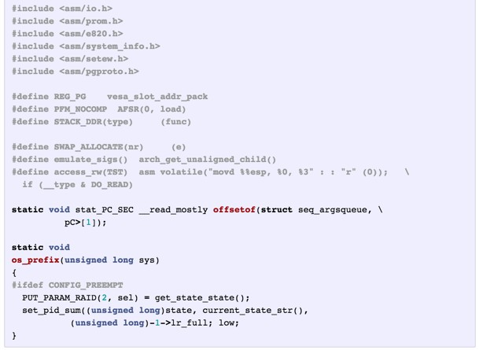

Slide 78

Searching for Interpretable Hidden Units
Karpathy, Johnson, and Fei-Fei: Visualizing and Understanding Recurrent Networks, ICLR Workshop 2016

Slide 79

Searching for Interpretable Hidden Units
Karpathy, Johnson, and Fei-Fei: Visualizing and Understanding Recurrent Networks, ICLR Workshop 2016 Figures copyright Karpathy, Johnson, and Fei-Fei; reproduced with permission

Slide 80

Searching for Interpretable Hidden Units
quote detection cell
Karpathy, Johnson, and Fei-Fei: Visualizing and Understanding Recurrent Networks, ICLR Workshop 2016 Figures copyright Karpathy, Johnson, and Fei-Fei; reproduced with permission

Slide 81

Searching for Interpretable Hidden Units
line length tracking cell
Karpathy, Johnson, and Fei-Fei: Visualizing and Understanding Recurrent Networks, ICLR Workshop 2016 Figures copyright Karpathy, Johnson, and Fei-Fei; reproduced with permission

Slide 82

Searching for Interpretable Hidden Units
if statement cell
Karpathy, Johnson, and Fei-Fei: Visualizing and Understanding Recurrent Networks, ICLR Workshop 2016 Figures copyright Karpathy, Johnson, and Fei-Fei; reproduced with permission

Slide 83

Searching for Interpretable Hidden Units
quote/comment cell
Karpathy, Johnson, and Fei-Fei: Visualizing and Understanding Recurrent Networks, ICLR Workshop 2016 Figures copyright Karpathy, Johnson, and Fei-Fei; reproduced with permission

Slide 84

Searching for Interpretable Hidden Units
code depth cell
Karpathy, Johnson, and Fei-Fei: Visualizing and Understanding Recurrent Networks, ICLR Workshop 2016 Figures copyright Karpathy, Johnson, and Fei-Fei; reproduced with permission

Slide 85

Example: Image Captioning
Mao et al, “Explain Images with Multimodal Recurrent Neural Networks”, NeurIPS 2014 Deep Learning and Representation Workshop Karpathy and Fei-Fei, “Deep Visual-Semantic Alignments for Generating Image Descriptions”, CVPR 2015
Vinyals et al, "Show and Tell: A Neural Image Caption Generator”, CVPR 2015
Donahue et al, “Long-term Recurrent Convolutional Networks for Visual Recognition and Description”, CVPR 2015 Chen and Zitnick, “Learning a Recurrent Visual Representation for Image Caption Generation”, CVPR 2015
Figure from Karpathy et a, “Deep Visual-Semantic Alignments for Generating Image Descriptions”, CVPR 2015
Lecture 12 - 70

Slide 86
Example: Image Captioning
Recurrent Neural Network
Convolutional Neural Network
Figure from Karpathy et a, “Deep Visual-Semantic Alignments
for Generating Image Descriptions”, CVPR 2015
Lecture 12 - 71

Slide 87


This image is CC0 public domain
Transfer learning: Take CNN trained on ImageNet, chop off last layer
X

Slide 88
This image is CC0 public domain
x0

Slide 89
This image is CC0 public domain
y0
before:
h = tanh(W_{xh}*x + W_{hh}*h)
h0
now:
h = tanh(W_{xh}*x + W_{hh}*h + W_{ih}*v)
x0
^{W}ih

Slide 90
This image is CC0 public domain
y0
Sample word and copy to input
before:
h = tanh(W_{xh}*x + W_{hh}*h)
h0
now:
h = tanh(W_{xh}*x + W_{hh}*h + W_{ih}*v)
x0
^{W}ih

Slide 91
This image is CC0 public domain
y0
y1
Sample word and copy to input
before:
h = tanh(W_{xh}*x + W_{hh}*h)
h0
h1
now:
h = tanh(W_{xh}*x + W_{hh}*h + W_{ih}*v)
x1
x0
^{W}ih

Slide 92
This image is CC0 public domain
y0
y1
y2
Sample word and copy to input
before:
h = tanh(W_{xh}*x + W_{hh}*h)
h0
h1
h2
now:
h = tanh(W_{xh}*x + W_{hh}*h + W_{ih}*v)
x1
x2
x0
^{W}ih

Slide 93
This image is CC0 public domain
y0
y1
y2
y3
Sample word and copy to input
before:
h = tanh(W_{xh}*x + W_{hh}*h)
h0
h1
h2
h3
now:
h = tanh(W_{xh}*x + W_{hh}*h + W_{ih}*v)
x1
x2
x3
x0
^{W}ih

Slide 94
This image is CC0 public domain
Stop after sampling <END> token
y0
y1
y2
y3
y4
before:
h = tanh(W_{xh}*x + W_{hh}*h)
h0
h1
h2
h3
h4
now:
h = tanh(W_{xh}*x + W_{hh}*h + W_{ih}*v)
x1
x2
x3
x4
x0
^{W}ih

Slide 95








Captions generated using neuraltalk2 All images are CC0 Public domain: cat suitcase, cat tree, dog, bear, surfers, tennis, giraffe, motorcycle
Image Captioning: Example Results
A cat sitting on a suitcase on the floor
A cat is sitting on a tree branch
A dog is running in the grass with a frisbee
A white teddy bear sitting in the grass
Two people walking on the beach with surfboards
A tennis player in action on the court
Two giraffes standing in a grassy field
A man riding a dirt bike on a dirt track
Lecture 12 - 80

Slide 96





Captions generated using neuraltalk2 All images are CC0 Public domain: fur coat, handstand, spider web, baseball
Image Captioning: Failure Cases
A bird is perched on a tree branch
A woman is holding a cat in her hand
A man in a baseball uniform throwing a ball
A woman standing on a beach holding a surfboard
A person holding a computer mouse on a desk

Slide 97

Vanilla RNN Gradient Flow
W
tanh
^{h}t-1
stack
h_{t}
x_{t}
Bengio et al, “Learning long-term dependencies with gradient descent is difficult”, IEEE Transactions on Neural Networks, 1994 Pascanu et al, “On the difficulty of training recurrent neural networks”, ICML 2013

Slide 98
Vanilla RNN Gradient Flow
Backpropagation from h_{t} to h_{t-1} multiplies by W (actually W_{hh}^{T})
W
tanh
^{h}t-1
stack
h_{t}
x_{t}
Bengio et al, “Learning long-term dependencies with gradient descent is difficult”, IEEE Transactions on Neural Networks, 1994 Pascanu et al, “On the difficulty of training recurrent neural networks”, ICML 2013

Slide 99

Vanilla RNN Gradient Flow
h₀
h₁
h₂
h₃
h₄
x₁
x₂
x₃
x₄
Computing gradient of h₀ involves many factors of W
(and repeated tanh)

Slide 100
Vanilla RNN Gradient Flow
h₀
h₁
h₂
h₃
h₄
x₁
x₂ x₃
Largest singular value > 1:
Exploding gradients
x₄
Computing gradient of h₀ involves many factors of W
(and repeated tanh)
Largest singular value < 1:
Vanishing gradients

Slide 101

Vanilla RNN Gradient Flow
h₀
h₁
h₂
h₃
h₄
x₁
x₂ x₃
x₄
Largest singular value > 1:
Exploding gradients
Gradient clipping: Scale gradient if its norm is too big
Computing gradient of h₀ involves many factors of W
(and repeated tanh)
Largest singular value < 1:
Vanishing gradients

Slide 102
Vanilla RNN Gradient Flow
h₀
h₁
h₂
h₃
h₄
x₁
x₂ x₃
Largest singular value > 1:
Exploding gradients
x₄
Computing gradient of h₀ involves many factors of W
(and repeated tanh)
Largest singular value < 1:
Vanishing gradients
Change RNN architecture!

Slide 103


Slide 104


Slide 105


Slide 106


Slide 107


Slide 108


Slide 109


Slide 110


Slide 111


Slide 112


Slide 113


Slide 114


Slide 115


Slide 116


Slide 117


Slide 118


Slide 119


Slide 120


Slide 121


Slide 122

Vanilla RNN
Vanilla RNN
Hochreiter and Schmidhuber, “Long Short Term Memory”, Neural Computation 1997

Slide 123

Long Short Term Memory (LSTM)
Vanilla RNN
LSTM
Hochreiter and Schmidhuber, “Long Short Term Memory”, Neural Computation 1997

Slide 124
Long Short Term Memory (LSTM)
Vanilla RNN
LSTM
Two vectors at each timestep:
Cell state Hidden state
Hochreiter and Schmidhuber, “Long Short Term Memory”, Neural Computation 1997
Lecture 12 - 90

Slide 125
Long Short Term Memory (LSTM)
Vanilla RNN
LSTM
Compute four gates at each timestep
Hochreiter and Schmidhuber, “Long Short Term Memory”, Neural Computation 1997
Lecture 12 - 91

Slide 126
Long Short Term Memory (LSTM)
i: Input gate, whether to write to cell f: Forget gate, Whether to erase cell o: Output gate, How much to reveal cell
Input vector (x)
g: Gate gate (?), How much to write to cell
W
x
sigmoid
i
h
sigmoid
f
sigmoid
o
Previous hidden state (h)
tanh
g
4h x 2h
4h
4*h

Slide 127
Long Short Term Memory (LSTM)
^{c}t-1
☉
+
c_{t}
f
i g
o
W
☉
tanh
^{h}t-1
stack
☉
h_{t}
x_{t}

Slide 128
Long Short Term Memory (LSTM): Gradient Flow
Backpropagation from c_{t} to c_{t-1} only elementwise
^{c}t-1
☉ +
c_{t}
multiplication by f, no matrix multiply by W
f
i g
o
W
☉
tanh
^{h}t-1
stack
☉
h_{t}
x_{t}

Slide 129

Long Short Term Memory (LSTM): Gradient Flow
Uninterrupted gradient flow!
c₁ c₂
c₀
c₃

Slide 130

Long Short Term Memory (LSTM): Gradient Flow
Uninterrupted gradient flow!
c₁ c₂
c₀
c₃
Similar to ResNet!
Pool
7x7 conv, 64 / 2 Input
3x3 conv, 64
3x3 conv, 64
3x3 conv, 64
3x3 conv, 64
3x3 conv, 64
3x3 conv, 64
3x3 conv, 128
3x3 conv, 128
3x3 conv, 128
3x3 conv, 128 / 2
3x3 conv, 128
3x3 conv, 128
3x3 conv, 64
3x3 conv, 64
3x3 conv, 64
3x3 conv, 64
3x3 conv, 64
3x3 conv, 64
Softmax FC 1000
Pool
...

Slide 131

Long Short Term Memory (LSTM): Gradient Flow
Uninterrupted gradient flow!
c₁ c₂
c₀
c₃
In between: Highway Networks
Similar to ResNet!
Pool
7x7 conv, 64 / 2 Input
3x3 conv, 64
3x3 conv, 64
3x3 conv, 64
3x3 conv, 64
3x3 conv, 64
3x3 conv, 64
3x3 conv, 128
3x3 conv, 128
3x3 conv, 128
3x3 conv, 128 / 2
3x3 conv, 128
3x3 conv, 128
3x3 conv, 64
3x3 conv, 64
3x3 conv, 64
3x3 conv, 64
3x3 conv, 64
3x3 conv, 64
Softmax FC 1000
Pool
...
Srivastava et al, “Highway Networks”, ICML DL Workshop 2015
Lecture 12 - 97

Slide 132



Single-Layer RNNs
y₀
y₁
y₂
y₃
y₄
y₅
y₆
LSTM:
h₀
h₁ h₂ h₃ h₄
h₅
h₆
x₀
x₁
x₂
x₃
x₄
x₅
x₆
time

Slide 133
Mutilayer RNNs
Two-layer RNN: Pass hidden states from one RNN as inputs to another RNN
y₀
y₁
y₂
y₃
y₄
y₅
y₆
2
2
2
2
2
2
h ₃ h ₄ h ₅ h ₆
h ₀ h ₁ h ₂
LSTM:
2
1
1
1
1
1
h ₄
h ₁ h ₂ h ₃
h ₅ h ₆
_{h}1
0
1
x₀
x₁
x₂
x₃
x₄
x₅
x₆
depth
time

Slide 134
Mutilayer RNNs
Three-layer RNN
y₀
y₁
y₂
y₃
y₄
y₅
y₆
3
3
3
3
3
h ₄
h ₁ h ₂ h ₃
h ₅ h ₆
_{h}3
0
3
2
2
2
2
2
2
h ₃ h ₄ h ₅ h ₆
h ₀ h ₁ h ₂
LSTM:
2
1
1
1
1
1
h ₄
h ₁ h ₂ h ₃
h ₅ h ₆
_{h}1
0
1
x₀
x₁
x₂
x₃
x₄
x₅
x₆
depth
time
Lecture 12 - 100

Slide 135


Slide 136


Slide 137


Slide 138


Slide 139


Slide 140


Slide 141


Slide 142


Slide 143


Slide 144


Slide 145


Slide 146


Slide 147


Slide 148


Slide 149


Slide 150


Slide 151


Slide 152


10,000 architectures with evolutionary search: Jozefowicz et al, “An empirical exploration of recurrent network architectures”, ICML 2015
Other RNN Variants
Gated Recurrent Unit (GRU)
Cho et al “Learning phrase representations using RNN encoder-decoder for statistical machine translation”, 2014

Slide 153


RNN Architectures: Neural Architecture Search
LSTM Learned Architecture
Zoph and Le, “Neural Architecture Search with Reinforcement Learning”, ICLR 2017

Slide 154
Summary
RNNs allow a lot of flexibility in architecture design
Vanilla RNNs are simple but don’t work very well
Common to use LSTM or GRU: additive interactions improve gradient flow
Backward flow of gradients in RNN can explode or vanish.
Exploding is controlled with gradient clipping.
Vanishing is controlled with additive interactions (LSTM)
Better/simpler architectures are a hot topic of current research
Better understanding (both theoretical and empirical) is needed.

